Slide 1
Firms in international trade
Prof PDF Strydom
Extra-ordinary professor: School of Economics and TRADE research entity

Slide 2
1. Heterogeneous firms
Monopolistic competition
Serving domestic and foreign markets
Highly concentrated
Firm
High cost of trade participation
Select
Efficient
Highly Productive
Capital intensive
High margins
Quality People
Large Profits
Inefficient firms exit
Resource allocation

Slide 3
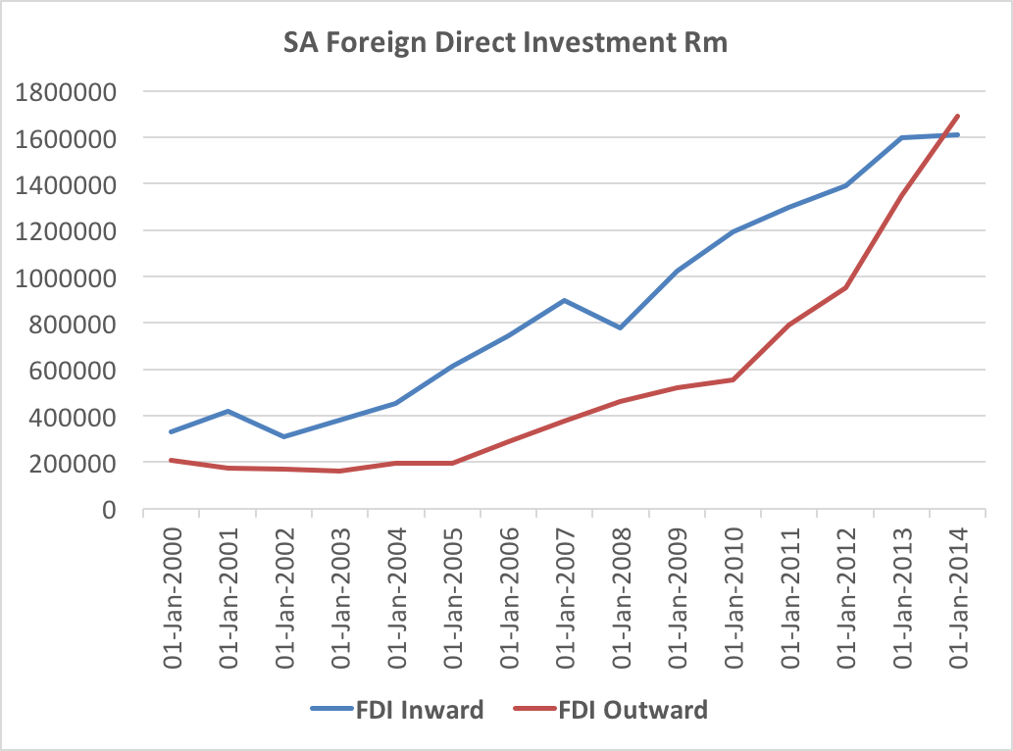
2. Firm behaviour in South Africa

Slide 4
3. Policy suggestions
First principles: Stylized facts
Trade agreements: Cross border inefficiencies and tariffs
Package approach:
Quality human capital and flexible labour markets
Regulatory framework
Infrastructure:
Electricity
ICT requirements
Logistics

Slide 5
Thank you

